Slide 1


Strategies for Promoting Complex Social Play in
Children with Autism Using
Photographic Activity Schedules
Thomas S. Higbee, Ph.D., BCBA-D, LBA
Professor and Interim Department Head
Department of Special Education & Rehabilitation
Executive Director, ASSERT Autism Program
Utah State University

Slide 2


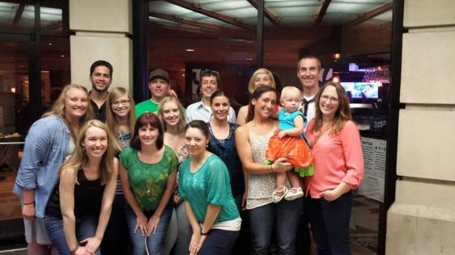

Acknowledgments
The Innovators at PCDI
My Students
Lynn McClannahan
Pat Krantz
Greg MacDuff
(and others)

Slide 3
Why teach (and research) play?
“Play is a young child’s work”
Play serves an important function in typical development
Through play, children learn social rules and norms
Play has significant social validity
It’s really fun to do this kind of work/research!

Slide 4
Social and Communication Deficits
Deficits in spontaneous language and social behavior, including play, are defining characteristics of students with Autism Spectrum Disorder (ASD)
Even students who acquire extensive verbal skills through behavioral intervention often do not exhibit spontaneous social interactions or initiations without extensive training
They also make fewer social initiations compared to typical peers and spend more time playing alone
Many have difficulty initiating tasks independently and transitioning from one task/activity to another
Photographic activity schedules and social scripts are tools that have been shown to be effective in addressing these deficits

Slide 5
Scripts and Script Fading
Social scripting is one set of techniques designed to promote social interactions in individuals with ASD
“A script is an audiotaped or written word, phrase, or sentence that enables young people with autism to start or continue conversation (McClannahan & Krantz, 2005).”
Notes:
Scripts are not intended to teach children with autism to speak but are procedures for teaching them to interact with others.
The intention is to teach the reciprocity of a conversation, the give and take, I say something you say something different.
Children with autism may have extensive vocabularies, may be able to spontaneously mand for preferred items and tact hundreds of objects, have learned to greet others and answer dozens of questions but these skills do not guarantee that they will engage in or initiate conversation. Scripts can be a useful teaching strategy for students who have small or large vocabularies.

Slide 6
Scripts and Script Fading
After children reliably follow the scripts, the scripts are then systematically faded back to front.
After scripts are introduced and then faded, children often continue to use the learned scripts when they are not present and combine parts of scripts or language used by their conversation partner, thus producing spontaneous unscripted language (McClannahan & Krantz, 2005).
Notes:
Scripts are most beneficial when they are individualized for the child based on the child’s ability to imitate

Slide 7
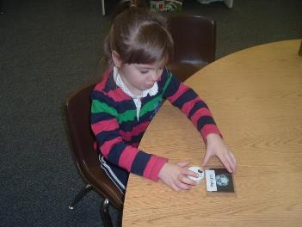
Script Formats
Text-based: written script that the participant reads and repeats
Auditory: script is recorded on an electronic device that the participant listens to and repeats
“I like to eat chips.”
“I like to eat____.”
“I like to ______.”
“I like________.”
“I___________.”
______________

Slide 8


Sibling-Implemented Script Fading to Promote Play-Based Statements in Children with Autism
Jessica S. Akers, Thomas S. Higbee,
Joy S. Pollard, & Kassidy S. Reinert
Utah State University

Slide 9
Script fading
Reagon and Higbee (2009) taught parents to implement the script fading procedure with their children with ASD.
The purpose of the study was to extend the use of script and script fading procedures to a home setting by train parents to help create, implement and systematically fade scripts to promote appropriate social interactions in young children with autism about play activities.

Slide 10
Participants and Setting
3 young children with ASD and their typically developing sibling
  Sadie and Melissa, Cameron and Landon, Hank and Mandy
Participants selected:
  One parent was interested in volunteering to participate
  One sibling was willing to participate
  The child had the ability to speak in 3-4 word phrases
  Setting: Participants’ homes

Slide 11
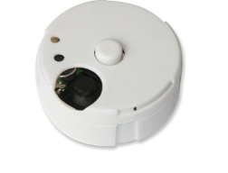
Materials
Three toy sets
  One target toy had scripts
Scripts: voice recorders approximately 5 cm in diameter with a small button in the center
All sessions were recorded

Slide 12
Measures
Play-based initiations:
  Contextually appropriate statements
  2 or more words
  Different from the previous statement
  Could only use same phrase 4 times per session

Slide 13
Procedures
Sessions were 3 min
“Let’s play”
  Typically developing sibling was instructed to
    Not ask questions or give directions
    Respond to the participants comments
    Only talk about what they were doing
  Only during treatment were scripts presented for the target toy
Notes:
Each time sessions were conducted all three toys were played with

Slide 14
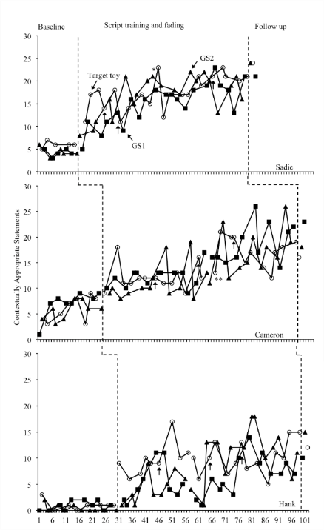

Slide 15
Discussion
Once the treatment was introduced the number of comments made by the participants increased
We were able to completely fade scripts for all three participants
Results maintained at follow-up

Slide 16
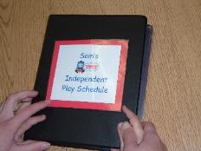
Photographic Activity Schedules
“…a set of pictures or words that cues someone to engage in a sequence of activities.”
(McClannahan & Krantz, 1999, p.3)
Beginning schedules are often comprised of a set of photos of stimuli that are presented sequentially in a small 3-ring binder
The learner independently completes the sequence using the schedule to prompt him/her instead of adult instructions

Slide 17
Why teach children to follow schedules? Because everybody uses them!
Schedules provide visual/auditory prompts to engage in certain activities at certain times
They make our lives more predictable and allow us to plan future activities
Examples of schedules include:
  Smartphones
  Planners/Calendars
  “To-Do” lists
  Sticky notes
Schedule following is a lifelong skill!
Why not teach it early?

Slide 18
Sequence of Schedule Following
Opening schedule book
Point to page
Obtain item
Perform activity
Return item to original location
Return to schedule book
Turn page
Repeat for all pages
After terminal reinforcer, turn last page and put schedule away

Slide 19
Prompting Procedures
“Prompts are instructions, gestures, demonstrations, touches or other things that we arrange or do to increase the likelihood that (the learner) will make a correct response (McClannahan & Krantz, 1999, p. 37).”
Activity schedules teach learners to initiate and complete a sequence of activities without verbal directions
To accomplish this, a prompt fading system called “graduated guidance” is used to teach schedule following

Slide 20
Prompting
Schedule following is taught using physical guidance exclusively
A prompting/prompt fading system of most-to-least intrusive prompts is used to prevent errors and promote fluid schedule following
Physical guidance is faded as quickly as possible
Do not prompt using gestures (e.g., pointing) or verbal instructions

Slide 21
Graduated Guidance
Fading Procedures:
  Full physical/Hand over hand
  Partial Physical
  Light Physical
  Proximity
Fade both within activities and across schedule sequence

Slide 22
An Evaluation of Photographic Activity Schedules to Increase Independent Playground Skills in Young Children with Autism
Jessica S. Akers, Thomas S. Higbee, Joy S. Pollard, Kristina R. Gerencser, Azure J. Pellegrino
Utah State University

Slide 23
Purpose and Research Questions
Evaluate the effectiveness of a photographic activity schedule to increase independent appropriate play skills in young children with ASD on the playground
To what extent will a photographic activity schedule increase the number of appropriate play activities completed by children with ASD on the playground without adult support?
To what extent will a photographic activity schedule increase the amount of time children with ASD are engaged in appropriate behaviors on the playground without adult support?

Slide 24
Participants and Setting
Three male students with ASD ages 4-5 attending ASSERT preschool
Fluent activity schedule followers
Engaged in inappropriate behavior on the playground
Outdoor play area on the university campus
Notes:
Fluent activity schedule followers: 3 sessions at 80% or better accuracy

Slide 25
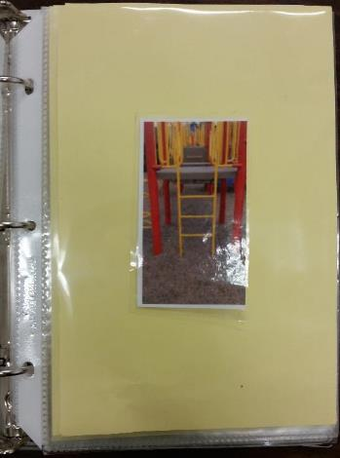
Materials
Small 3-ring binder with pictures attached using Velcro
Pool of 8 activities
  Randomly selected and resequenced
Schedules had a variable number activities individualized across participants and a terminal reinforcer (small snack)
Added 4 activities to highest number of activities completed in baseline (Miles 5, Alvin 8, Dexter 7)

Slide 26
Measurement
The number of different playground activities completed
The percentage of independently completed schedule components completed (when schedule was present)

Slide 27
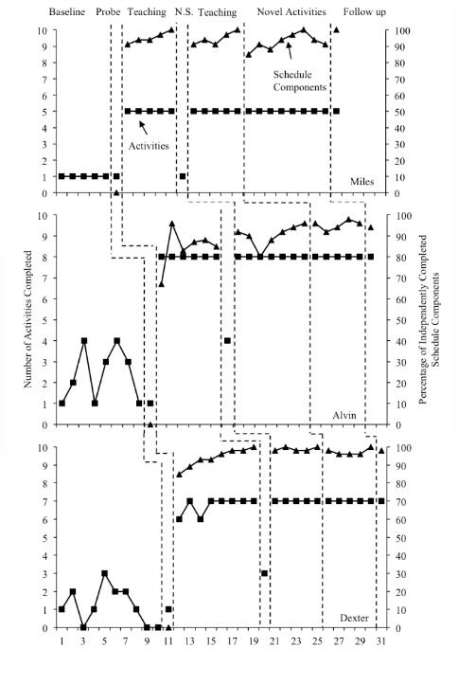

Slide 28
Discussion
All three participants engaged in more activities when the activity schedule was present
Limitation: We did not make any attempts to fade the activity schedules (but we have demonstrated that this is possible in a subsequent study)

Slide 29
Combining Social Scripting and Photographic Activity Schedules to Promote Complex Social Behavior

Slide 30
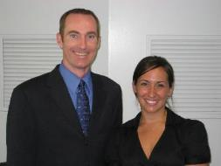
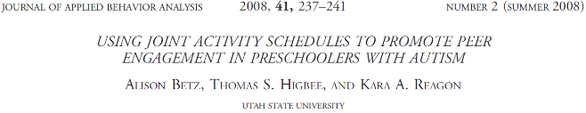
Using Joint Activity Schedules to Promote Peer Engagement in Preschoolers with Autism
Alison Betz, Kara Reagon, &
Thomas S. Higbee
Utah State University

Slide 31
Purpose
The purpose of the current study was to extend the research of MacDuff, Krantz, and McClannahan (1993) by examining the effects of teaching two children with autism to follow a joint activity schedule with scripts on play initiations and engagement with a peer during play.
Notes:
Say this: Although the research cited above has demonstrated effective methods to increase social interaction and initiations, to date, no studies have examined the effects of a joint activity schedule in which two children with autism follow the same schedule on peer play or peer interactions. Based on the demonstrated effectiveness of independent activity schedules and scripts, the primary purpose of the current study is to extend the literature on peer play by systematically replicating MacDuff et al (1993). The current study examines the effects of teaching two children with autism to follow a joint activity schedule on peer play. A secondary purpose of this study is to examine the effects of scripts and script fading procedures within a peer play schedule on play initiations between two children with autism

Slide 32
Joint Activity Schedules
2 children share one book
Each page has photo of one child (that child is responsible for that activity)
  Photo of child
  Photo of activity, or choice
  Script, or other cue for student to initiate to peer:
    “Play with me.”
    “Want to play?”
    “Let’s play _______.”

Slide 33
Methods
Participants:
  3 dyads of preschool aged children with autism
    5 boys, 1 girl
  Ranging from ages 3-5
  All fluent independent activity schedule followers
Dependent Variables:
  Joint Social Engagement-Both participants engaged in the activity specified by the schedule (or appropriately playing the same game during baseline)
  Play initiations-Repeating the “Play with me” script to the other child
Design
  Non-concurrent multiple baseline
  design across dyads
Notes:
As a fluent schedule follower, the participants could follow an independent activity schedule with no prompts, with novel activities, and in any sequence. They could also choose activities they would like to engage in when given several options, and use a timer for open ended activities.

Slide 34
Methods
4 activity pages
  2 pages per participant
    One pre-chosen game page
    One choice page
Discrimination of the pages
  Picture of the participant on the top
Pre-chosen page
  A picture of the game they were to play with displayed under the picture of the participant
Choice page
  An empty page under the picture of the participant
  Choice board consisted of 4 choices
Notes:
There were 4 pages in the joint activity schedule. Each participant within a dyad had a pre-chosen game page and an page which they could choose which game to play. At the top of the page was a picture of the participant who was responsible for that page. This signaled which participant was responsible for initiations, choices, obtaining materials and putting the materials away. For the pre-chosen page, there was a picture that represented the game in which the participants were to play in the middle of the page. For the choice page, the middle of the page was empty. This signaled the participants to choose a picture of a game they would like to play from choice board consisting of 4 pictures of different games. After choosing which game he would like to play, the participant would then bring the picture to the schedule and stick it to the page.
For all pages, the script was displayed at the bottom of the page.

Slide 35
Notes:
This graph represents peer engagement and the number of games completed together. The x axis represents sessions the primary y axis is percentage of intervals and the secondary y axis represents the number of games played together. The open boxes represent games played, the closed boxes represent prompted engagement, and the closed triangles represent independent social engagement.
For Dyad 1, peer engagement was low during baseline and with the implementation of the teaching phase, immediately increased and remained high. They remained in teaching because one participant, Ali, did not meet the script phase change criteria which I will discuss in a moment. After entering into maintenance, peer engagement remained high. They currently have completed the resequencing phase and will be entering into generalization next. Games played also immediately increased during the teaching phase and remained at the maximum of 4 games throughout the following phases
For dyad 2, engagement was around 30% during baseline and they only played one game together. Peer engagement and games played immediately increased after implementing the teaching phase as well and remained high through all phases. With dyad 2, we conducted a reversal probe to see if peer engagement would remain without the joint activity schedule. As you can see, in the first probe engagement remained high, however, they were only engaged with one highly preferred game. During the second session without the schedule, they did not play together at all. We reintroduced the schedule in the generalization phase, and engagement immediately increased to levels prior to the reversal.
For the third dyad, baseline was more variable. They played up to three games together, but interaction was very brief and peer engagement was variable, with an average of approximately 30% engaged. After implementing the teaching phase, peer engagement slightly increased, however it took them almost twice as many sessions to meet the phase change criteria. This may be because of two reasons. Anecdotal reports from the instructors said one participant was prompt resistant and engaged in inappropriate behavior when prompted and the participants expressed “boredom” from the games, making comments that they didn’t want to play theses games any more. However, after implementing the maintenance phase, the peer engagement remained high. They are currently in the resequencing phase.

Slide 36
Conclusions
All three dyads in this study followed a joint activity schedule and maintained schedule following without adult prompts
Two dyads maintained schedule following during resequencing and the introduction of new games
The use of scripts and scripts fading procedures embedded in a joint activity schedule increased play initiations toward peers in all participants
Scripts were successfully faded for all participants except for Ali in dyad 2
Therefore, joint activity schedules using play initiation scripts is a promising tool to increase peer engagement with two children with autism

Slide 37
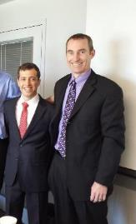
The Use of Linked Activity Schedules to Promote Social and On-task Behaviors During a Game of Hide-and-Seek
Matthew T. Brodhead, Thomas S. Higbee,
Joy S. Pollard, Jessica S. Akers, and Nina Gerencser
Utah State University

Slide 38
Current Research Goal
Extend Betz, Higbee, and Reagon (2008) by using activity schedules to maintain on-task and social behavior in the participant’s immediate, natural environment
Hide and seek typically occurs in a large-scale environment where the child can not see the entire area at once
  Requires stimulus control by the immediate, natural environment
  Social interactions dominate the game
  Time pressure
  Lots of potential hiding places
  More potential for distraction
  One schedule per participant

Slide 39
Methods
Non-concurrent multiple baseline design
Six children (3 pairs-Fluent activity schedule followers)
Setting: On-campus preschool for children with autism
Prior to the beginning of the study, we taught
  Textual responses (i.e., script following)
    Three second constant time delay
  Picture-location correspondence
    Manual guidance
    Locations: under tables, offices, hallways, remote corners of the room
Measure: % appropriate hide and seek behaviors

Slide 40
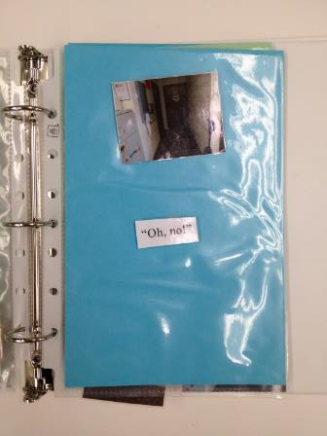
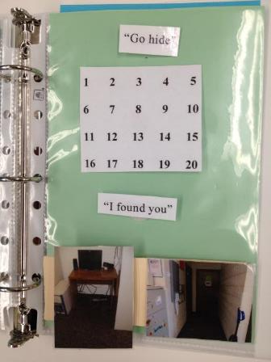
Hider
Seeker

Slide 41
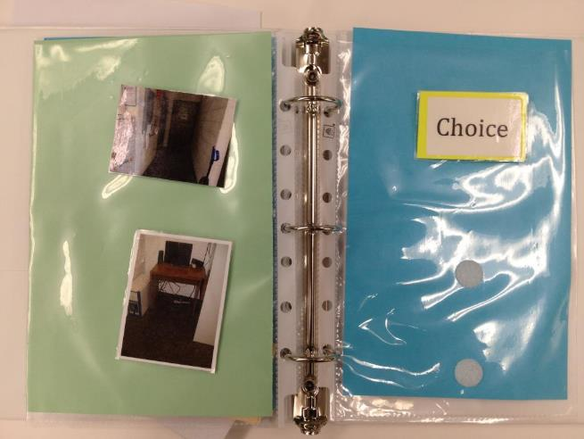

Slide 42
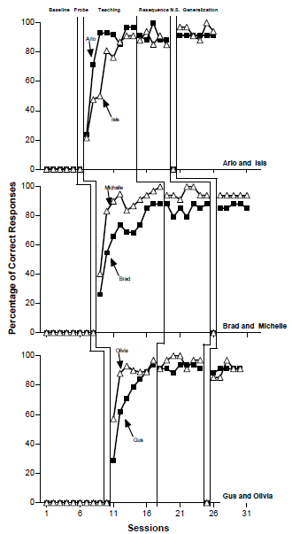

Slide 43
Discussion
Linked activity schedules can maintain social and on-task behavior during a complex social game like hide-and-seek
As predicted, social and on-task behaviors did not occur when the schedule was removed
Demonstrates the potential of activity schedules for teaching complex social behaviors
Limitation: No fading of the schedule

Slide 44
An Evaluation of Group Activity Schedules to Train Children with Autism to Play Hide-and-Seek with Typically Developing Peers
Jessica A. Akers, Thomas S. Higbee, Kristina Gerenscer, Azure Pellegrino, Bethany Contreras, & Lorraine Becerra
Utah State University

Slide 45
Purpose
The purpose of this study was to assess using group activity schedules to teach children with autism to play a complex social with typically developing peers
Extend the research on using activity schedules to teach social skills by using group activity schedules
Examine the effects of systematically fading the schedule
Notes:
Did you like using the schedule binders to play hide and seek
Would you play hide and seek again
Open ended question

Slide 46
Target Participants
Penny
  3 year old
  Language deficits
  Interested in peers but lacked the skills to initiate play
Dexter
  5 year old
  Advanced academic skills
  Primarily initiated play and conversation with adults
  Spent therapy time in the classroom with peer participants
Sadie
  5 year old
  Advanced academic skills
  Basic social skills
  Spent therapy time in the classroom with peer participants
Notes:
We define fluent activity schedule followers as independently following their activity schedules with 90% or better accuracy for 3 consecutive sessions
Peer participants wouldn’t want to play

Slide 47
Peer Participants
Twelve typically developing children (peer participants)
Attending university preschool
Four of the peer participants were males and eight were females
Four of the peer participants were 5 years old and eight were 4 year olds
Three peer participants played hide-and-seek during the session with each child with autism

Slide 48
Setting
University Early Childhood Center
    Baseline, Teaching, Fading Sessions: common area outside of the classrooms
      Cubbies, tables, chairs, and observation rooms
    Generalization sessions: outdoor play area
      Sandbox, slide, toys, playhouses

Slide 49
Materials & Research Design
Schedules
  Two 3-ring binders
  Construction paper inserted in page protectors
  Pictures attached with Velcro
Video cameras
  One for each participant (4)
A non-concurrent multiple baseline design across play groups

Slide 50
Hide-and-Seek Game Rules
We required each participant to play the role of the seeker at least once during the game
We did not allow the participants to play the role of the seeker in pairs
We also required participants to hide in different locations from other players

Slide 51
Procedures-Identical for All Participants
Baseline:
  Activity schedules were not present
  Sessions were 10 min
  No prompts
Activity schedule probe
  Activity schedules were present
  No prompts
Generalization Probes
  Outside play area

Slide 52
Procedures
Teaching
  Participants were physically prompted to use the schedules
    Dexter required one booster session to practice hider behaviors
Scripts
  Seeker: “Found you”, “See you”, and “Got you”
  Hider: “Oh no”, “Dang it”, “Ahh man”
No schedule probe
  Followed the same procedures as baseline

Slide 53
Procedures
Fading
  Followed the same procedures as teaching but schedules were systematically faded
Follow up
  2 weeks after treatment
  Did not provide any prompts
  Schedule present at last successful fading step

Slide 54
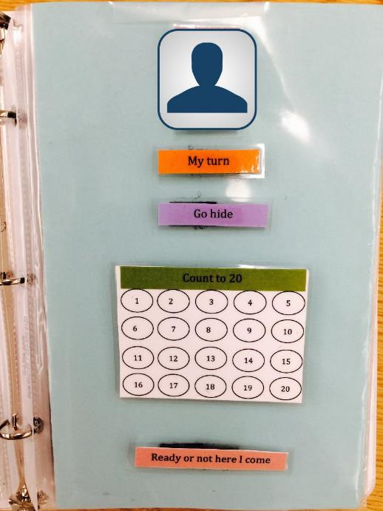
General Procedures-
Seeker Schedule

Slide 55
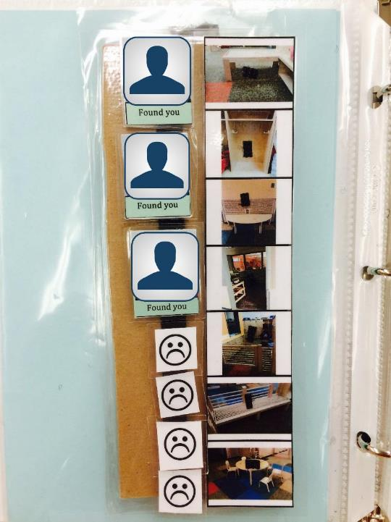
General Procedures-
Seeker Schedule

Slide 56
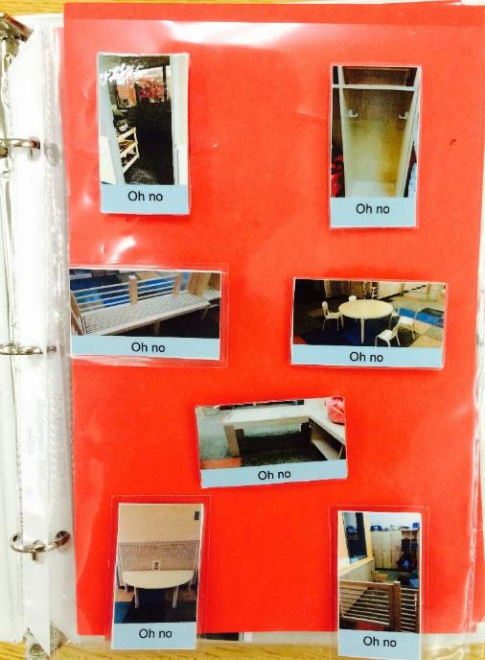

Slide 57
Script Fading
Scripts were faded after one session at 85% or better based on performance of the target child with ASD
Scripts were faded one word or one portion of the script at a time from the end of the phrase to the beginning, including the colored strip attached to scripts
Scripts were completely faded for all three participants
Scripts
  Seeker: “Found you”, “See you”, and “Got you”
  Hider: “Oh no”, “Dang it”, “Ahh man”

Slide 58
Schedule Fading
Fading was initiated after three consecutive sessions at 90% or better independent responding
Fading from one step to another was one sessions at 90% or better independent responding
Systematic fading steps:
  Removed the numbers in circles for counting to 20
Notes:
Criteria: 2 sessions at 90% or better to initiate fading, 1 session at 90% to move to next fading step

Slide 59
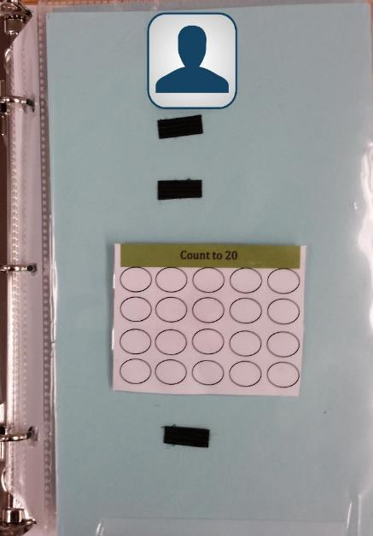


Slide 60
Systematic fading steps:
  Removed the numbers in circles for counting to 20
  Removed the circles for counting to 20
Notes:
Criteria: 2 sessions at 90% or better to initiate fading, 1 session at 90% to move to next fading step

Slide 61
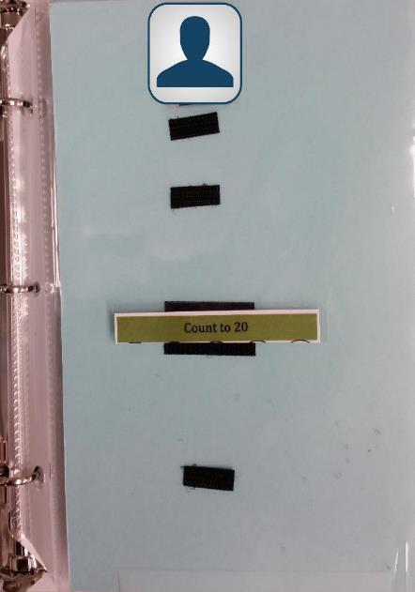


Slide 62
Systematic fading steps:
  Removed the numbers in circles for counting to 20
  Removed the circles for counting to 20
  Removed pictures of locations from the seeker strip and hider binder
Notes:
Criteria: 2 sessions at 90% or better to initiate fading, 1 session at 90% to move to next fading step

Slide 63
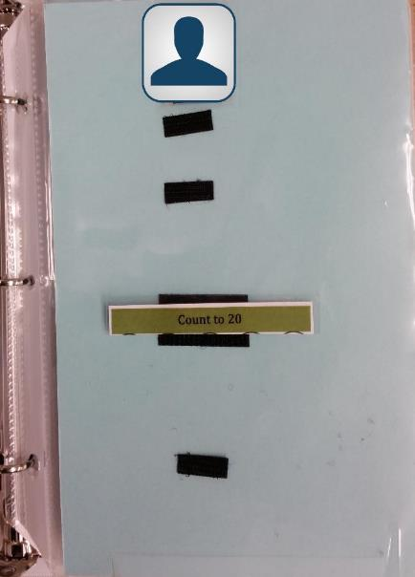
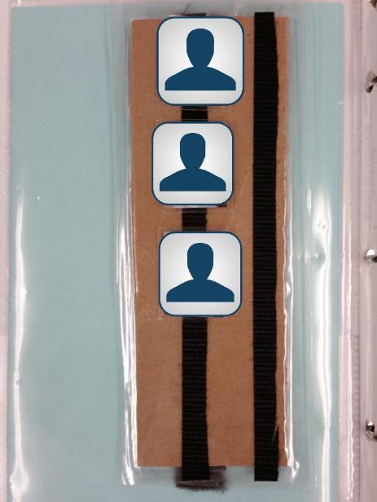
No Hider Binder

Slide 64
Systematic fading steps:
  Removed the numbers in circles for counting to 20
  Removed the circles for counting to 20
  Removed pictures of locations from the seeker strip and hider binder
  Removed the seeker strip and direction count to 20
Notes:
Criteria: 2 sessions at 90% or better to initiate fading, 1 session at 90% to move to next fading step

Slide 65

No back page

Slide 66
Systematic fading steps:
  Removed the numbers in circles for counting to 20
  Removed the circles for counting to 20
  Removed pictures of locations from the seeker strip and hider binder
  Removed the seeker strip and direction count to 20
  One sheet of construction paper with pictures of players
Notes:
Criteria: 2 sessions at 90% or better to initiate fading, 1 session at 90% to move to next fading step

Slide 67
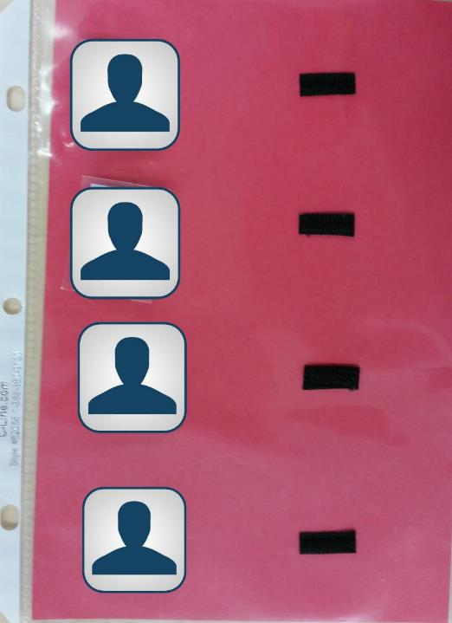

Slide 68
Systematic fading steps:
  Removed the numbers in circles for counting to 20
  Removed the circles for counting to 20
  Removed pictures of locations from the seeker strip and hider binder
  Removed the seeker strip and direction count to 20
  One sheet of construction paper with pictures of players
  Removed the seeker schedule
Notes:
Criteria: 2 sessions at 90% or better to initiate fading, 1 session at 90% to move to next fading step

Slide 69
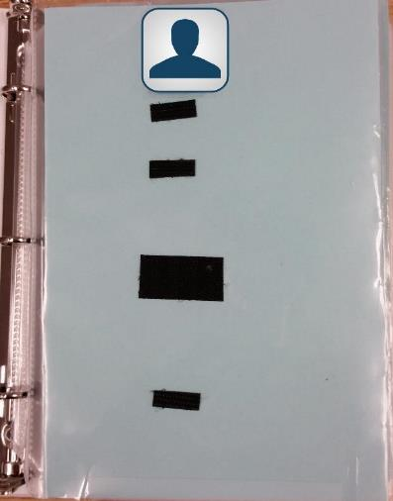
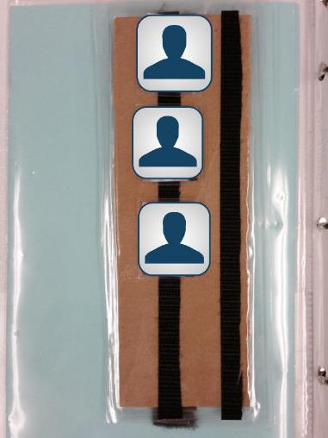
Dexter’s 3rd fading step

Slide 70
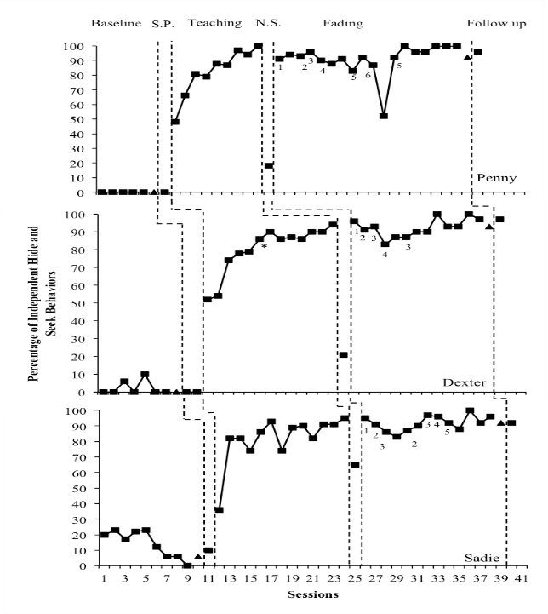

Slide 71
Variability in Language Use

Slide 72
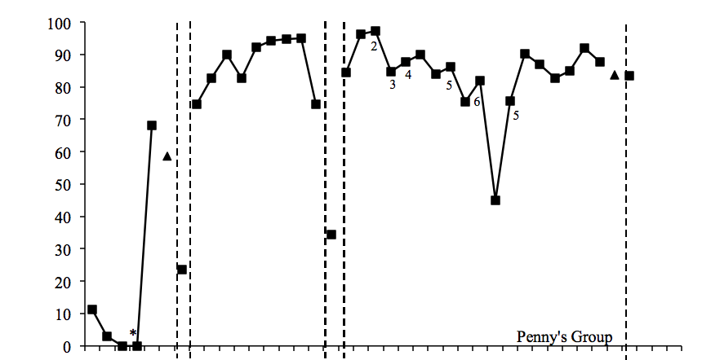
Baseline S.P. Teaching N.S. Fading Follow up
Percent Correct
Sessions

Slide 73
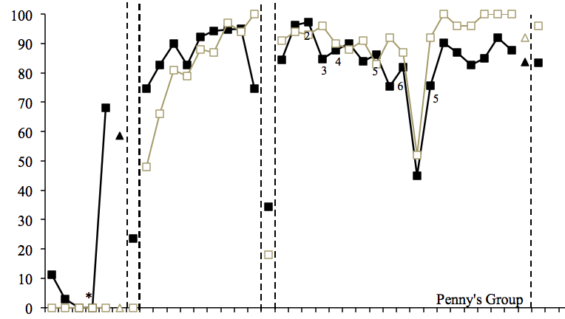
Baseline S.P. Teaching N.S. Fading Follow up
Percent Correct
Sessions

Slide 74
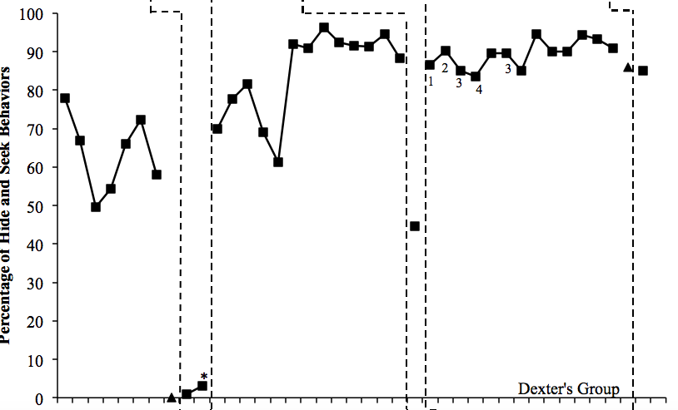
Baseline S.P. Teaching N.S. Fading Follow up
Percent Correct
Sessions

Slide 75
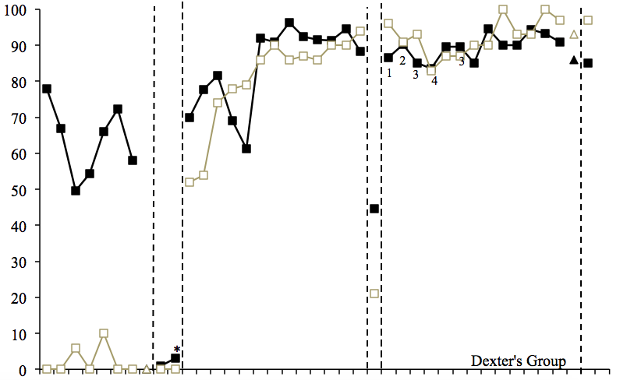
Baseline S.P. Teaching N.S. Fading Follow up
Percent Correct
Sessions

Slide 76
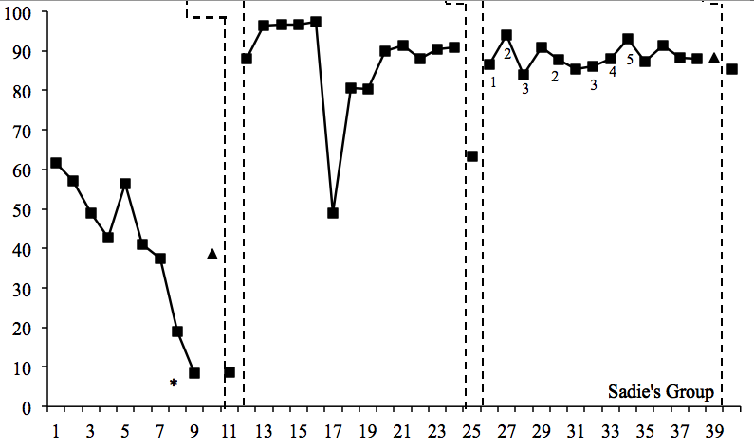
Baseline S.P. Teaching N.S. Fading Follow up
Percent Correct
Sessions

Slide 77
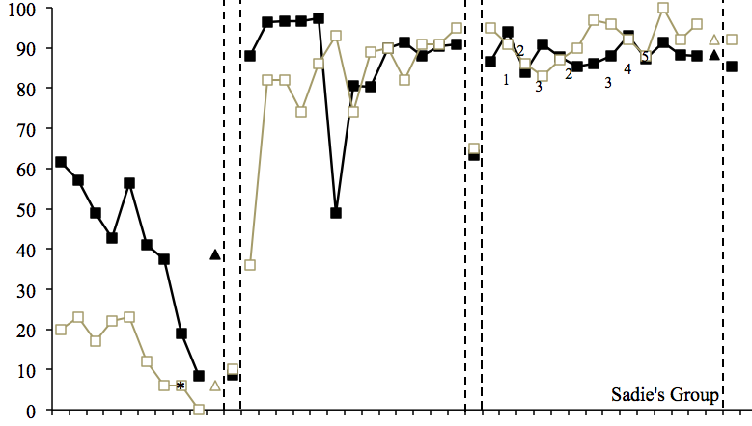
Baseline S.P. Teaching N.S. Fading Follow up
Percent Correct
Sessions

Slide 78
Discussion
Extends the results of Brodhead et al. (2014)
Target and peer participants were able to follow complex schedules
  Seven possible hiding locations
    Once hider binder was faded completely, the number of possible locations increased
All three target participants were able meet the criteria for fading and were able to play hide-and-seek with a faded version of the schedule
Two of the target participants were able to play hide-and-seek with a single sheet of paper displaying the order of seekers

Slide 79
Discussion
All three target participants learned the general behaviors of hiding and seeking
  Participants hid in novel locations
  Participants searched for other players in an appropriate manner
    Did not memorize the sequence of hiding locations presented during teaching
Generalization sessions
  Independently found appropriate hiding locations and were able to locate hiders in this new environment

Slide 80
Summary
This is the first study to use activity schedules to teach a group of children to play a complex social game
  One child with ASD and three typically developing peers
This study was the first to attempt to systematically fade schedule components
  Participants were able to continue playing the game even when the majority of schedule components were faded
Notes:
Future directions: may use older kids, might use looser definitions
Other types of game play in which schedules could be faded

Slide 81
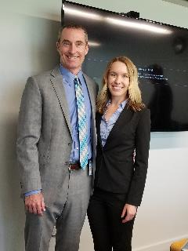
Promoting Sociodramatic Play Between Children with Autism and their Typically Developing Peers Using Activity Schedules
Azure Pellegrino, Thomas S. Higbee, Lorraine A. Becerra,
Lyndsay D. Nix, & Katelin A. Hobson
Utah State University

Slide 82
Purpose
Extend the literature on activity schedules by investigating the extent to which linked activity schedules increase sociodramatic play in children with ASD with their typically developing peers
Investigate the extent to which the linked activity schedules can be faded and the same levels of sociodramatic play continue to be observed

Slide 83
Target Participants
Three 4-year-olds with ASD
  Bruce
  Tobias
  Hazel
Fluent activity schedule followers
  Echoed four-word phrases
  Followed simple instructions
  Demonstrated independent play skills
  Demonstrated deficits in social play with peers

Slide 84
Peer Participants
Eight typically-developing 4- to 5-year-olds
Two peer participants participated with any target participant during each session on a volunteer basis
Peer participants did not participate in additional baseline sessions after being exposed to treatment

Slide 85
Setting
Common area of a university-based preschool for children with ASD
Two small tables, two small chairs, one built-in bench and cabinets

Slide 86



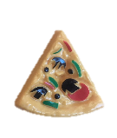


Materials
Wearable Items
Toy Food
Notes:
Our materials were for a restaurant scenario. This is because it’s a common sociodramatic play scenario for preschoolers, and it lends itself well to three separate roles (waiter, diner, and chef).

Slide 87
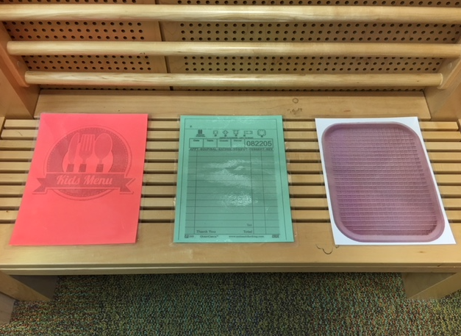
Materials

Slide 88
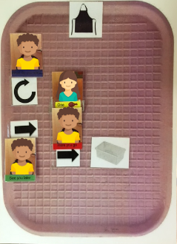
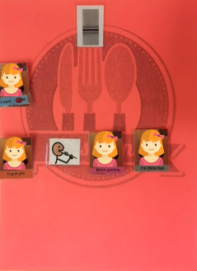
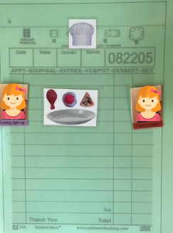
Materials

Slide 89
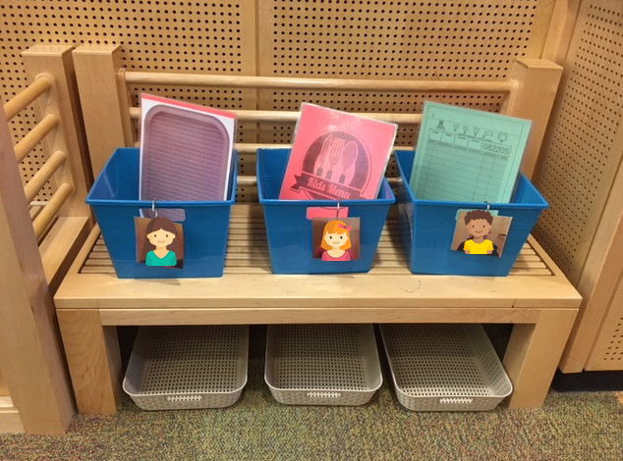
Materials

Slide 90
Response Definition and Measurement
Engagement: Independently engaging in interactive behaviors with peers corresponding to the restaurant scenario or engaging in scheduled behaviors- 20 s momentary time sample
Independent Schedule Completion: Independently engaging in behaviors (interactive and schedule following) programmed by the activity schedule
Varied Vocal Behavior: Independently emitting unscripted, contextually-appropriate words or phrases

Slide 91
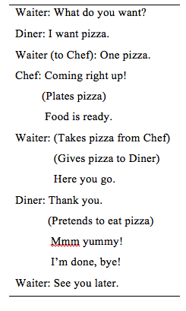
Rotation Example
Notes:
The activity schedules will be linked such that an interaction or interaction sequence from one participant to another will signal the beginning of an To get a better understanding of how this would look, I have a video of adults playing the roles of the participants. You’ll see initial instruction be given, and one rotation of the play sequence.
*After: questions?*
interaction or interaction sequence for that other participant.

Slide 92
Schedule Fading Steps
Pictures of wearable items removed
Eating icon and food pictures removed
Arrow icons and bin pictures removed
Participant pictures from diner and chef schedules removed
Participant pictures from waiter schedule removed

Slide 93
Fading Step 5

Slide 94
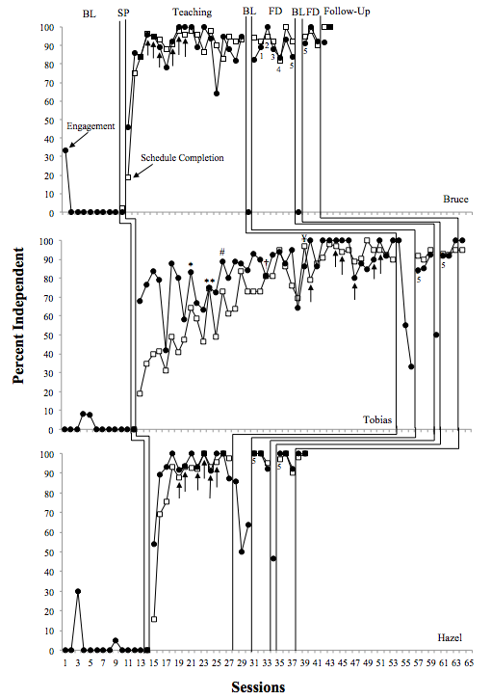

Slide 95
Unscripted Play Behaviors Completed More Than Once
Bruce
“Coming right up” as waiter | 4
“You’re welcome” | 2
“That’s it, I’m done, bye” | 23
“That’s it, good job, bye” | 2
Made eating sounds | 17
“I want (food), please” | 4
Added peer’s name at the end of a vocalization | 2
Changed food order as diner | 4
Pushed plate toward the waiter as the diner | 16
Pushed plate toward the waiter as the chef | 14
Tobias
“Goodbye” | 4
“You’re welcome” | 2
“Here you go” as chef | 4
“See you later” as diner | 10
“I want (food)” as waiter | 23
Made eating sounds | 5
Pushed plate toward the waiter as the chef | 2
Pushed plate toward the diner as the waiter | 4
Hazel
“You’re welcome” | 3
Repeated “What do you want?” after no response | 2
Repeated “See you later” | 3
Made eating sounds | 7
Pushed plate toward the waiter as the diner | 6
Pushed plate toward the waiter as the chef | 3

Slide 96
Discussion
Replicated effects of linked activity schedules on play behavior with standard teaching practices with two participants (3rd participant with BST modifications)
Replicated effects of linked activity schedules on play behavior for peer participants
Replicated effects of fading the linked schedule
Extension to sociodramatic play
All participants learned all three roles

Slide 97
Discussion
All participants varied their sociodramatic play behaviors
High levels of appropriate play behavior during reversal phases
Expedited fading for two participants
Investigate in future studies:
  Pre-requisite skills
  More sensitive measures of play/engagement
  Promote and measure generalization

Slide 98
Final Thoughts
It’s important to teach children with autism how to play
We have evidence-based behavior analytic strategies to teach play
There remain many important play-related questions to be answered
Let’s play!

Slide 99
Thank You!!!
For further information contact:
Dr. Tom Higbee
Email: tom.higbee@usu.edu

