Slide 1



Application Information Session
PN and AAS Programs

Slide 2

Prepare now for the application
Learn in this workshop:
  What you’ll need to do prior to applying to the Nursing program
  What materials to have ready when you do apply
  What the timeline is
  Where and who to go to for questions

Slide 3
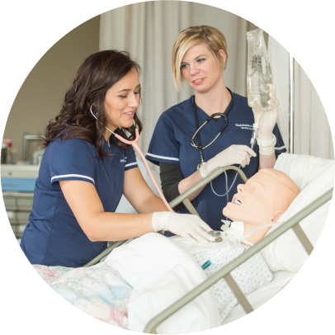
Make sure to complete all prerequisites:
REMEMBER!
B- or better grade required in all prerequisite courses
3 course attempts will be accepted
No more than 10 overall repeats, including transfer or equivalent course
If you have any questions regarding course attempts or repeats, please talk with your advisor
Notes:
PSY 1100 will also fulfill the prereq for HDFS 1500.
Three attempts means/= a class to be repeated twice (or first attempt, second attempt, third attempt)
BIOL 2520 and NURS 2500 are equivelent - ***highly encourage for students to take this course before PN program but can take course summer before start of RN program***

Slide 4
Program Prerequisite Courses (PN and AAS programs):
Practical Nurse Prerequisite Courses: | AAS (RN) Prerequisite Courses:
HDFS 1500 Human Development Across the Lifespan, or PSY 1010 General Psychology, or PSY 1100 Lifespan Development BIOL 2320 Human Anatomy (lab recommended but not required) BIOL 2420 Human Anatomy (lab recommended but not required) Certified Nurse Assistant or Medical Assistant Certification | Completion of a PN Program, including all PN prerequisite courses ENGL 1010 Introduction to Writing: Academic Prose CHEM 1010 Introduction to Chemistry or CHEM 1110 General Chemistry I (CHEM 1115 lab recommended but not required) NURS 2500 Pathophysiology Any Math QL (STAT 1040 or STAT 1045 recommended but not required)
Notes:
PSY 1100 will also fulfill the prereq for HDFS 1500.
BIOL 2520 will also fulfill the prerequisite for NURS 2500 - is a required prerequisite for the AAS in Nursing program – ***highly encourage for students to take this course before PN program but can take course summer before start of RN program***

Slide 5

Additional prerequisite information:
Students applying to the AAS Nursing program must also have a B- or higher in all PN courses
BIOL 2420 must be completed within five years of entrance to USU Nursing program*
Maximum limit of three attempts to complete each prerequisite course
* or must be completed within 5 years of entrance to PN program if moving directly into AAS Nursing program from USU's PN program or a technical college PN program
Notes:
5 year from Fall 2026 semester would be Fall 2021 semester
Fall 2020 if coming directly from a PN program

Slide 6
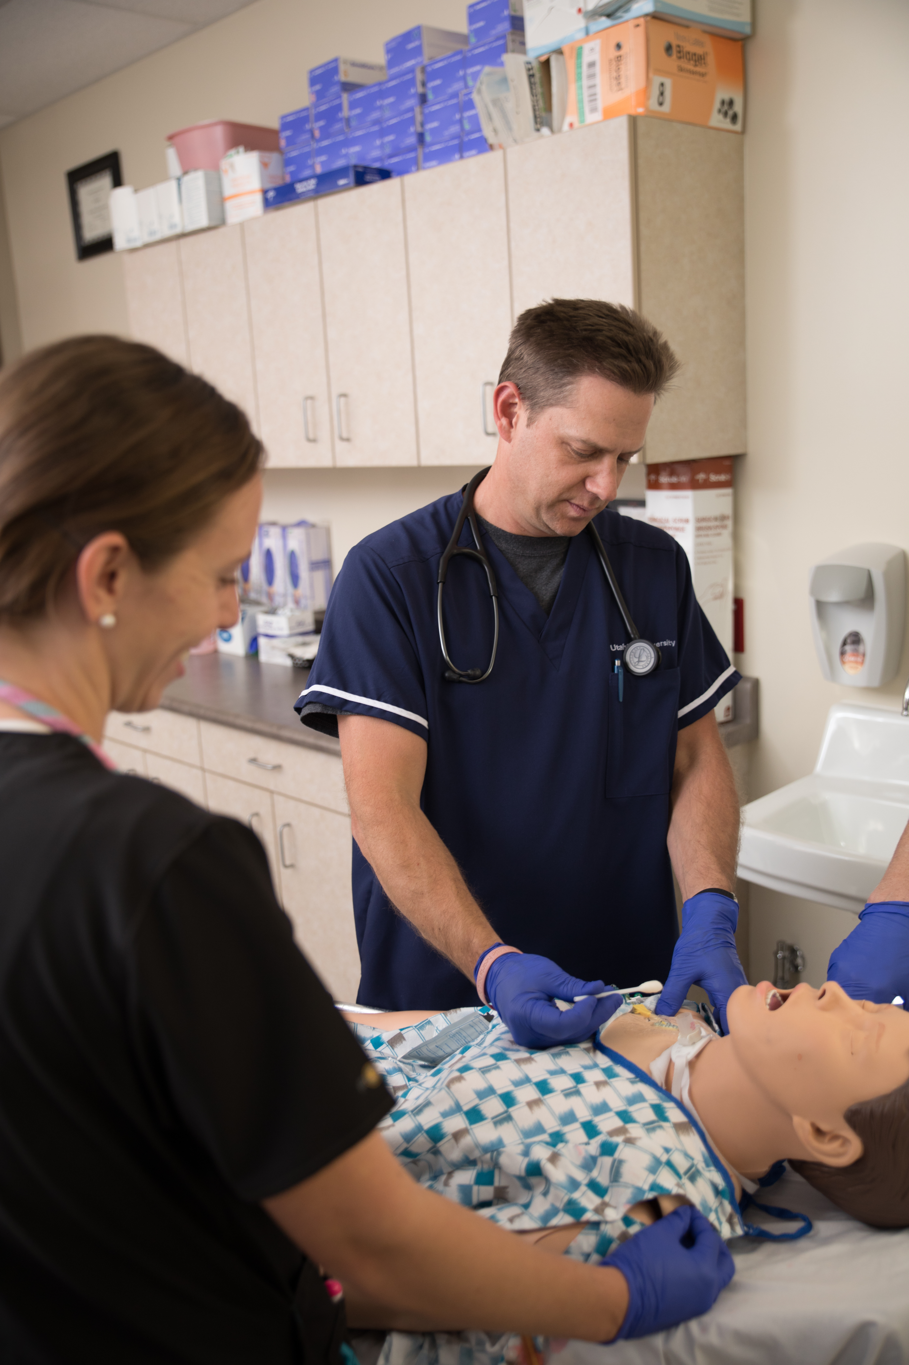
Additional prerequisite information:
  All remaining prerequisites must be completed by Summer semester of the application year (e.g. Summer 2026 semester for Fall 2026 Program Cohort)
*USHE Technical colleges include: Bridgerland Tech, Davis Tech, Uintah Basin Tech, Mountainland Tech, Ogden-Weber Tech, Southwest Tech, Tooele Tech, and Dixie Tech.
Notes:
The information below no longer pertains as all students will have Summer semester to finish any remaining prerequisites.
Information below no longer is relevant however, we will keep this for possible future use.
*Students applying for admission to the AAS program directly (Graduates in April/May 2024) from a tech college can complete their remaining prerequisite courses the summer prior to their Fall AAS cohort. If offered admission into the AAS program, they will be considered provisional admits and will need to receive final grades of B- of higher to be admitted into the program. They should plan to complete all program admission requirements on time (vaccinations, materials, etc).
If you completed a PN program earlier than April/May 2024, prerequisite courses need to be completed by the end of Spring Semester (e.g. if you completed PN program in November/December 2023 you will need to have prerequisite courses completed in Spring 2024 semester)

Slide 7
Let’s make sure we understand (easy)
EXAMPLE 2
John, a Uintah Basin Tech student, completed his PN program in May 2026. What is the latest that he can complete pre-requisites in order to enter USU’s Fall 2024 nursing cohorts?
Answer: John has until Summer 2026 semester to complete pre-requisite courses
EXAMPLE 1
Jane, a Davis-Weber Tech student, completed her PN program in December 2025. What is the latest that she can complete her pre-requisites to enter USU’s Fall 2026 nursing cohort?
Answer: Jane has until Summer 2026 semester to complete pre-requisite courses
Notes:
Although prerequisite can be complete the summer semester before starting fall semester – It’s HIGHLY encouraged students finish prerequisites, with B- or higher grade before they summer semester.

Slide 8
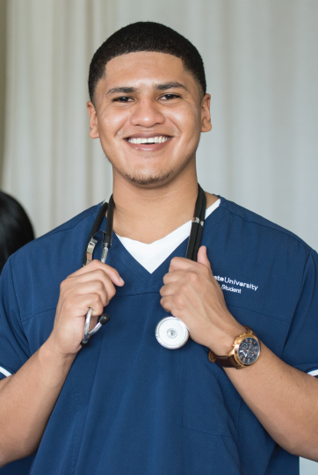
Application Process
Two Phase process
PHASE 1- submit the following
  General Application
  Resume Template
  Application Essay questions – Essay questions will be emailed each Friday
PHASE 2 – by invite
  Video Interviews
Notes:
Essay Question Essay - You will not see these questions as you upload your documents in the application. Essay questions and instructions will be emailed to applicants each Friday at 5:00 p.m MST during the application cycle. Any applications that have been submitted before Friday at 5:00 p.m. MST of that week will be sent the email at that time. If you do not see this email, check your email junk/spam folders. You will have one week to complete your essay questions from the time you receive your email.

Slide 9

Resume Template
Fill out PDF template
  Education
  Healthcare experience
  Non-Healthcare (work) experience
  Extra-curricular activites
  Remember a resume is the highlight of the work/experience that you want to bring attention to the nursing program.
  Be detailed and concise in your roles and responsibilities.
Notes:
If need help scheduling an appointment with a Career Coach, see your academic advisor as they will be happy to help you schedule an appointment with a career coach

Slide 10
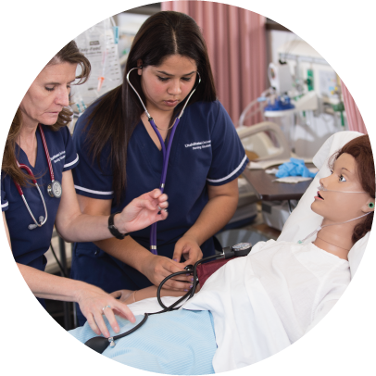
Application Essay
Questions will be emailed to you:
  Be prepared to write about your own personal experiences with topics such as care of others, life challenges, responsible behaviors, the many facets of diversity, and success.
Questions will be emailed, on a Friday – see How to Apply Website for more information

Slide 11
Tips/Helpful Information
Highlight personal experience and skills you’ll bring to the program:
  Volunteer, experience, research, leadership, problem solving, critical thinking, teamwork.
Be conscious of providing Too Much Information (TMI)
Be concise
Visit USU Career Design Center
  Using a career specialist can help with interviews
Notes:
USU Career Design Center

Slide 12
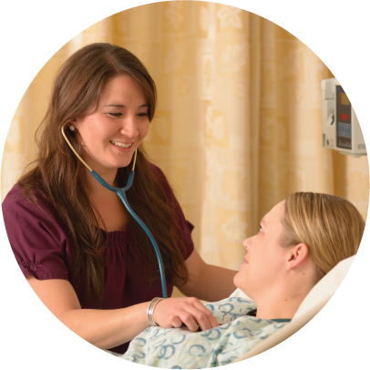
HESI Admission Assessment Exam
(HESI-A2)
Required for PN program applicants only
The HESI-A2 consists of three major content areas: English Language, Math, Science – and two personal assessment areas. The English Language covers reading comprehension, vocabulary and grammar. The Math covers basic math skills needed for healthcare (fractions, decimals, ratio and proportion, household measures). The Science covers biology, chemistry, and Anatomy & Physiology. The personal assessment covers learning style and personality profile. These two areas are not graded but offers the student and Nursing program good insight into your learning profile.
Total testing time is 5 hours and 25 minutes.

Slide 13

HESI A2 Exam
Get informed with schedules and deadlines
Test prep materials and programs
Study: Elsevier offers a study guide- (https://evolve.elsevier.com/cs/product/9780323353786?role=student)
Take exam and receive official score prior
to submitting application to program.
Successful completion (75% or better) is required.
  May take test two times if first score is low. Two weeks between attempts is required.
  HESI A2 scores older than two years will not be accepted.
**Take exam at one of the following USU Testing sites – Price, Moab, or Blanding
Notes:
Moab HESI A2 info: http://testing.usu.edu/locations/moab
Blanding HESI A2 info: https://blanding.usu.edu//testing/index
Price HESI A2 info: https://usueastern.edu/testing/
Taking HESI at a USU Testing Center, students need to schedule a day and pay USU Testing center. Call and plan ahead
Students can take an exam that is offered from USU from another university or institution, however students will need to contact the other school, institution or testing center to see if they can do that. See https://www.usu.edu/testing/students/non-usu-students for instruction.
Please review the How to Apply website of the nursing program you are applying for, to know if you need to take the HESI exam. Generally, applicants seeking to enter the USU’s PN program will need to take the HESI exam as part of the prerequisite requirement. HESI Exam not needed to enter the AAS RN program.

Slide 14

Phase 2 of the application process
Video interviews
Students will be notified of application status, and whether or not it was advanced to the subsequent phase.
Meeting the minimum requirements to apply to the Nursing Program does not guarantee acceptance
If invited to participate in Phase 2, please be sure to read all instructions carefully as you will only have one chance to complete your video interview (email will be sent)
Notes:
This will be video that they will record and submit – will only have one time so make sure you have reliable internet, create a room or space with no distractions and avoid using headphones. Use your laptop microphone

Slide 15
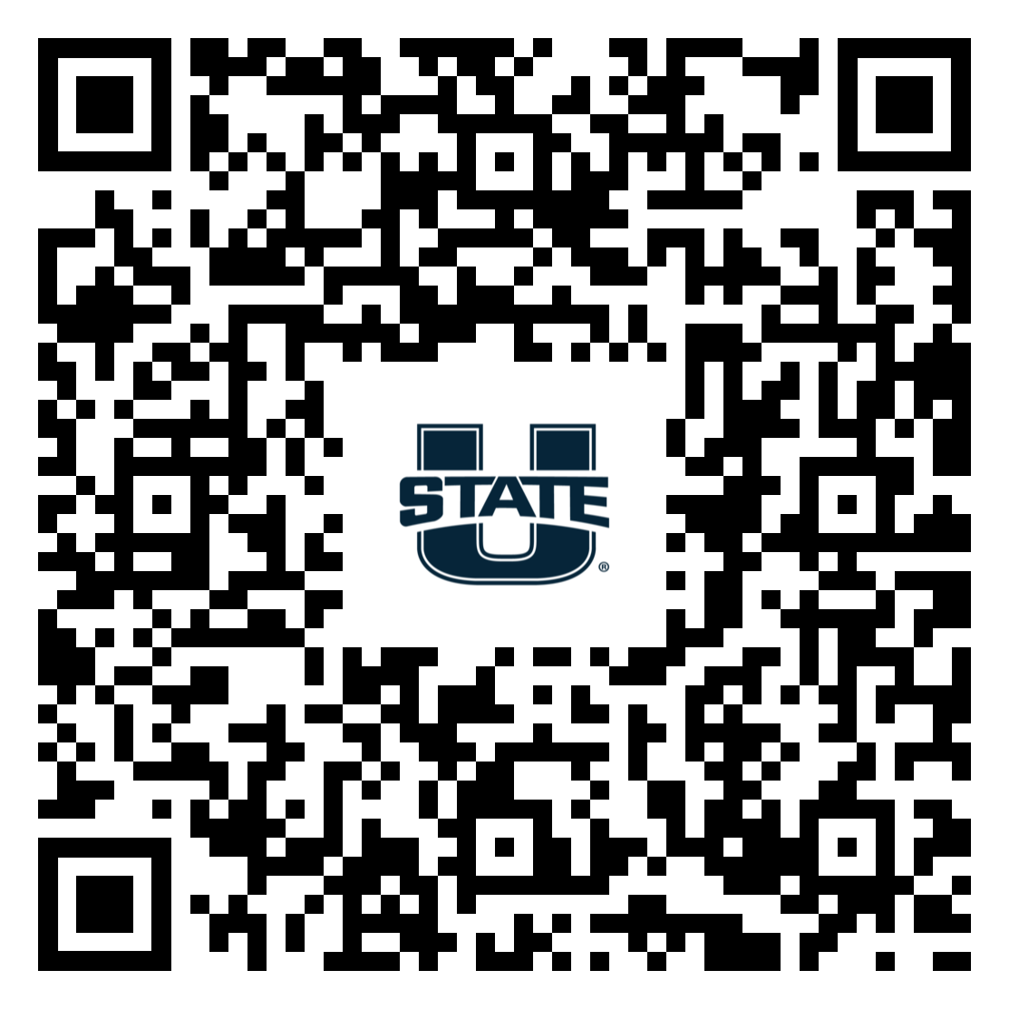
Career Coach
College of Education and Human Services
Alana Stowe – Career Design Specialist
(see QR code)
OR
LaNae Walker -Career Design Specialist for Statewide campuses
Email: Lanae.walker@usu.edu
Notes:
Other Career Coaches you can visit that maybe in your area

Slide 16
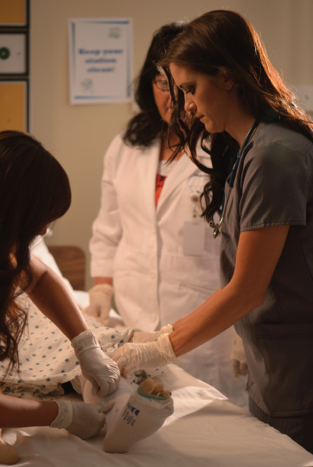
Application Submission
Have all documents in PDF format to upload
  Receipt of application payment (Paid through PayPal)
  HESI A2 score (PN applicants only)
  Resume Template
  Submit by February 15, 2026, deadline
  Upload CNA or MA Certificate (for PN program only) or PN License, if applicable
Students may receive email verification that application has been received – check junk mail
Notes:
Applicants will pay the application payment once they click on the How to Apply button, It will be Step 2. You will be taken to a link to pay the fee via PayPal
PDF format is highly encouraged. Because of the multiple programs reviewers use, not all file format opened as they should. PDF format ensures that file will be saved and well open correctly with being corrupted

Slide 17
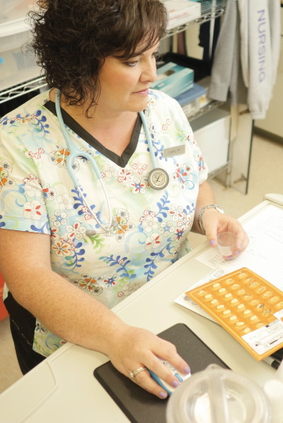
Accessing the Application
January 1 – February 15, 2026
Link active only during application
date range
Link will be accessible on the USU Nursing homepage
https://cehs.usu.edu/nursing/how-to-apply/index
Applicants should use Chrome or Firefox
Application must be completed in one sitting
Notes:
Internet Explorer is not a good browser to use for the application.

Slide 18
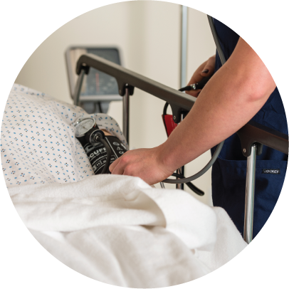
Who needs to apply?
Pre-Nursing students need to apply to the PN program.
PN students from other colleges who are applying to USU’s AAS Nursing program must complete the application in addition to being admitted to USU.
USU students who completed the USU PN program more than a year ago must complete the application. They may also need to reapply to USU.
What about current USU PN students applying to the AAS Nursing program?
  Current USU PN students need to complete and return the letter of intent form that they should have been given by the Nursing coordinator or staff. They return forms to Nursing staff assistants not advisors.
  Current USU PN students do not need to complete the online application.
Notes:
USU and Nursing program are two separate applications. Applicants must be admitted to USU first, before they can submit a PN or AAS nursing application.

Slide 19
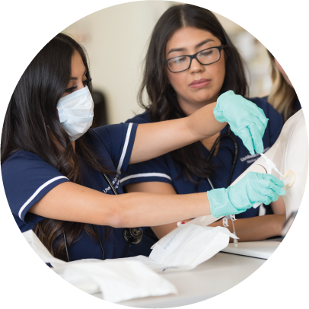
Helpful Tips
Once you hit “Submit”, do not hit the back button –
it clears out what you’ve previously entered into the application, and you’ll have to start over.
Be prepared with all materials prior to beginning the application. Save all documents as PDF, including payment receipt.
Once you submit, you’ll receive email confirmation.
Applicants will learn of acceptance typically within 6-8 weeks after the application cycle ends via email
For clinical or Nursing profession questions, meet with Nursing faculty at your location. Faculty are a wealth of information and are happy to meet with students to discuss Nursing as a career.
For prerequisite and major course questions, application questions, etc., please visit with your academic advisor. Advisors help with semester planning and help connect students to resources such as tutoring.
When it is time to apply for graduation, your
academic advisor will help make sure you’re on track to meet prerequisite and degree requirements.

Slide 20

Lastly
Students offered a position in the program who do not turn in their signed acceptance letter or turn it in after the deadline, will not be admitted into the program.
Follow-up on rejection letters with a thank you letter or email, and request feedback.
Read all emails from the Nursing department and stay on top of admission requirements/deadlines such as vaccinations, purchase of required materials, etc.
REMEMBER—All correspondence from the department/USU will be sent to your Anumber@usu.edu address.
Notes:
If you are offered a positon in the program, you will receive an official offer letter via email form the department. The due date to turn in your signed acceptance letter will be in the email. Make sure to read that email carefully and submit your acceptance before the deadline to ensure your spot in the program.
Advise students to check their preferred email that is in USU’s system – This most likely will be their a-number email, unless they are a transfer students then their email will be the most recent preferred email.

Slide 21

Department of Nursing
MMR – 2 vaccinations or titer showing immunity
Varicella (chicken pox) – 2 vaccinations or titer showing immunity
Hepatitis B* Accepted proof: documentation of two (Hepslav-B) OR three (recombivax HB and Engerix-B) vaccinations AND a surface antibody titer proving immunity (results of “reactive”)
TDaP – vaccination within the past 8 years
TB Tests – two 2-step skin tests or T-spot negative blood draw or QuantiFERON Gold negative blood draw
CNA certification – Logan BSN students only
CPR/Basic Life Support (BLS) for healthcare provider – certification approved by the American Heart Association (AHA)
Be careful of sites that say things like “follow AHA guidelines” these are not acceptable.
Background check and drug screen will be completed at the time you create your compliance account.
Flu vaccination will be done annually during fall semester of your USU nursing program.
* Hepatitis B: If you did not have Hepatitis B vaccinations as a child (or at any time prior) you may need to start a 2- or 3- series** Hepatitis B
vaccination process, if your initial Hepatitis B titer result is non-reactive.
** The Heplisav-B vaccine is new and requires only 2 injections. This is the 2-series vaccination. Recombivax HB and Engerix-B are 3-series vaccines.
In order to enter a USU nursing program, you must provide documentation showing that you have had the 2- or 3-
Series vaccines, and/or a Reactive titer, by August 1. We strongly encourage you to start this process as soon as possible.
Notes:
Pre-Clinical Requirements/vaccinations

Slide 22
Questions?
We are here to help.

Slide 23
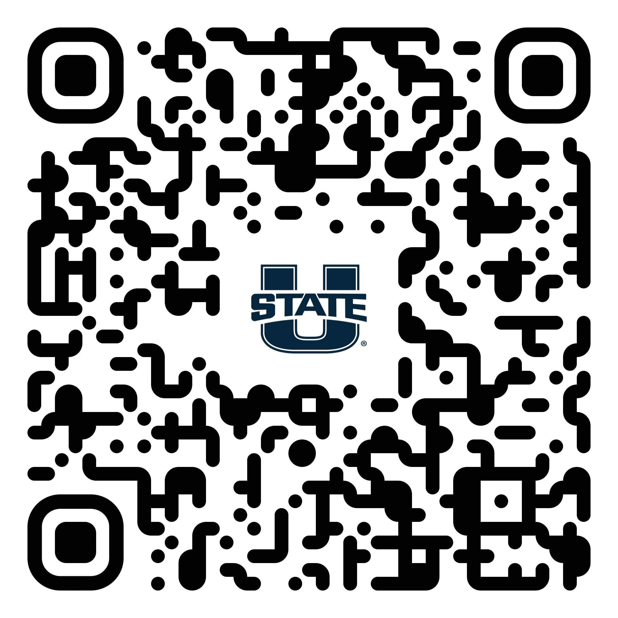
Practical Nurse – How to Apply Webpage
Notes:
QR Code for PN program – Ask student to bookmark page

Slide 24
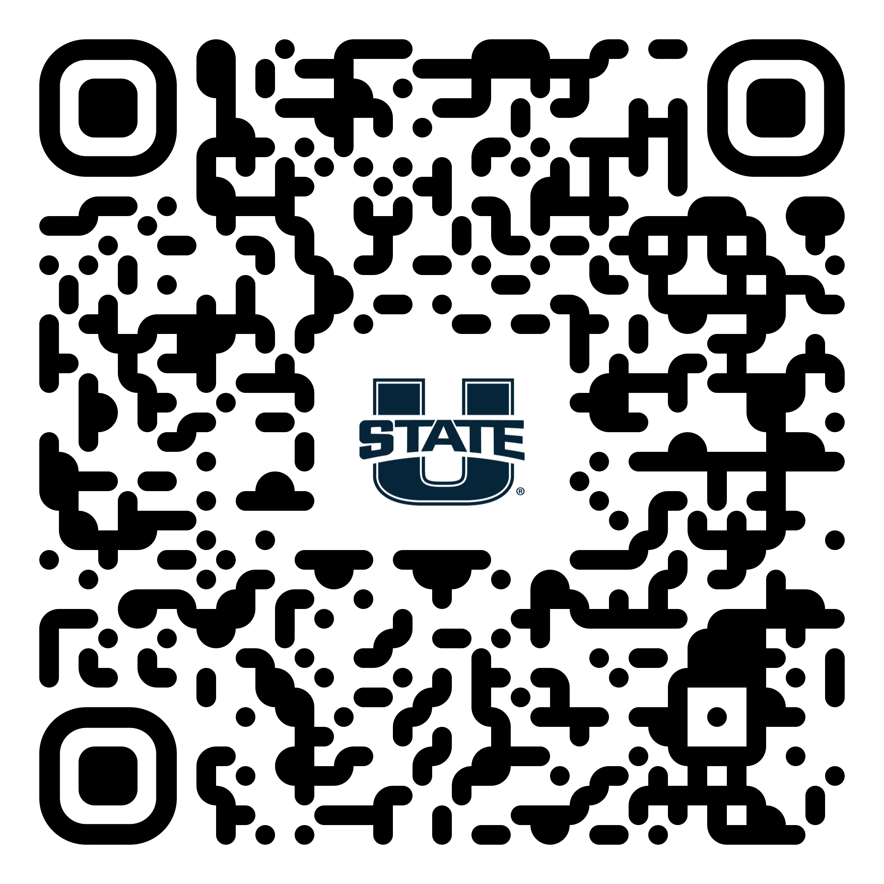
Associate of Applied Science (RN) Program – How to Apply Webpage
Notes:
QR Code for AAS Program – Ask students to bookmark page

